Slide 1
Project 3 – Predator & Prey
OOP 2011 Spring

Slide 2
Problem Statement
Simple 2-dimensional simulation
  Prey: rabbits
  Predator: foxes
  World: 20x20 grid cells
  Only one critter can occupy a cell at a time
  Critter is not allowed to move out of the given world

Slide 3
Simulation Space
20
 |  |  | X
 |  | O
20
X : fox
O : rabbit

Slide 4
Rabbit’s Action
Move
  At every time step, move randomly
    Up, down, left, right
    If the neighboring cell in selected direction is occupied or off the grid
      Stay in the current cell
Breed
  When a rabbit survives for three time steps, then at the end of the time step (that is; after moving)
    Creates a new rabbit in an adjacent cell which is empty
    No empty cell, no breeding occurs

Slide 5
Fox’s Action
Move
  If there is a rabbit in adjacent cell
    A fox will move to that cell and eat the rabbit
      Assume foxes do not eat each other
  Other rules are same as rabbit’s
Starve
  If a fox has not eaten a rabbit within the last three time steps, the fox will die at the end of the third time step

Slide 6
Fox’s Action (Con’t)
Breed
  If a fox survives for eight time steps
    Spawn off a new fox in the same manner as rabbits

Slide 7
Requirements
At the beginning, get the initial number of rabbits and foxes
  Exception handling is not required
Draw 2-dimensional world
  ‘O’ for rabbits
  ‘X’ for foxes
  ‘-’ for empty cell
  Use a 2-dimensional array (e.q., world[20][20])

Slide 8
Requirements (Con’t)
Print current time at the top of the screen
After each time step, prompt the user to press ‘Enter’ to move to the next time step
All foxes should move before rabbits do

Slide 9
Requirements (Con’t)
Create two classes (Mandatory!)
  1 for rabbits, 1 for foxes
    3 member variables: x & y coordinates, lifetime
    2 member functions: move(), breed()
  You can create additional classes, member variables, member functions if you need
Use srand() for random movement
Do not use inheritance !
Reasonable comment

Slide 10
Example Main Structure
Initialize()
Loop forever:
draw_world()
key_board_input()
Loop:
move
End loop
time step increased
End loop
Finalize()

Slide 11
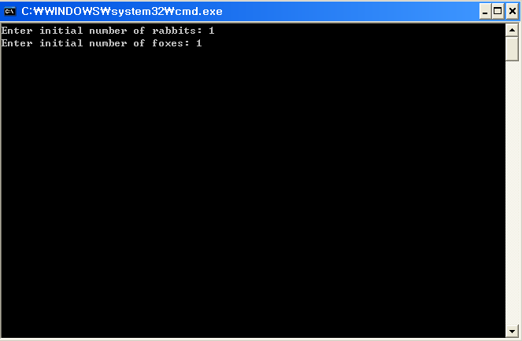
Example – Get input

Slide 12
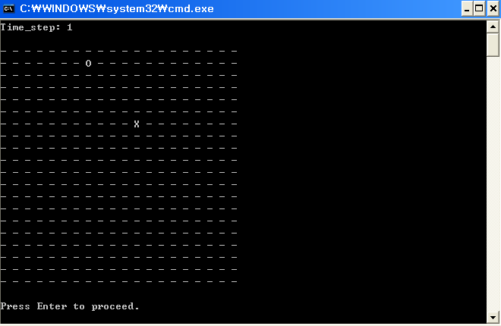
Example – Time step 1

Slide 13
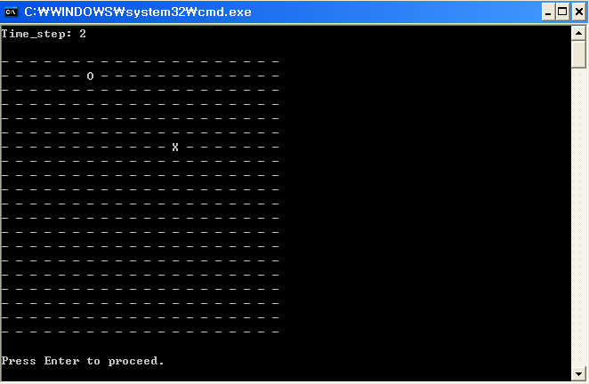
Example – Time step 2

Slide 14

Example – Time step 3

Slide 15
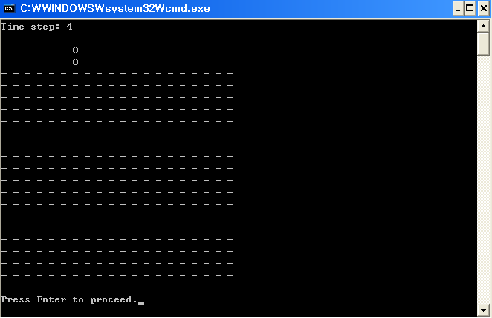
Example – Time step 4

Slide 16
Project Information
Due to April 24th 11:55pm @YSCEC
  10% penalty for one day delay
Zip only project folder. No doc required.
File name format
  [student ID]_3.zip ex) 07123456_3.zip
No compile: 0 point
Cheating(Copying): 0 point for all projects

Slide 17
Find your teammate
Project 5 and 6 is team project
The number of teammate : 3
Notice about your team is announced after the midterm exam

Slide 18
Q & A

